Slide 1
MICROWAVE SENSOR FOR HYDRATION MONITORING
Supervisor：Declan O'Loughlin
Xiaoru Liu
Progress Presentation

Slide 2

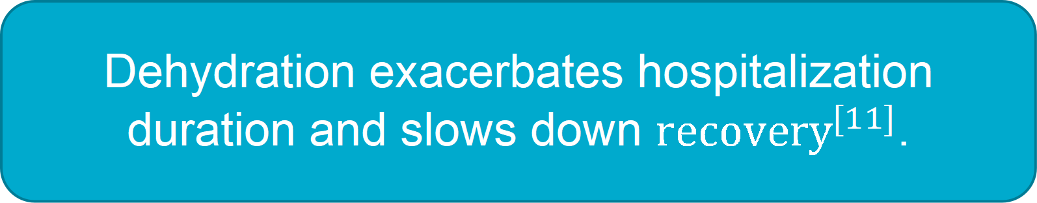
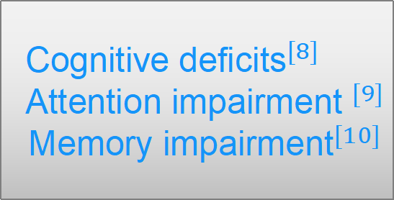
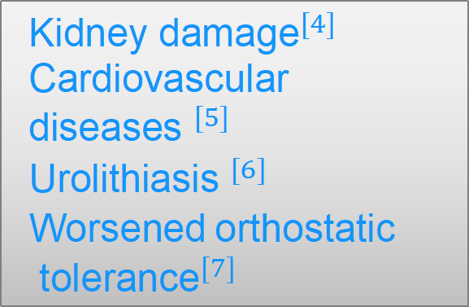
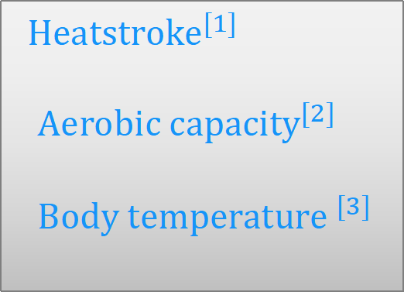
Introduction
Principle
Finished work
Future plan
Dehydration
Dehydration exacerbates hospitalization duration and slows down ${\text{recovery}}^{[11]}$.
Direct damage
Disease
Indirect effects
$${\text{Heatstroke}}^{[1]}$$
${\text{Aerobic} \text{capacity}}^{[2]}$
${\text{Body} \text{temperature} }^{[3]}$
$${\text{Kidney} \text{damage}}^{[4]}$$
Cardiovascular ${\text{diseases} }^{[5]}$
${\text{U}\text{rolithiasis} }^{[6]}$
Worsened$\text{orthostatic}$
$${ \text{tolerance}}^{[7]}$$
$${\text{Cognitive} \text{deficits}}^{[8]}$$
$${\text{Attention} \text{impairment} }^{[9]}$$
$${\text{Memory} \text{impairment}}^{[10]}$$
Trinity College Dublin, The University of Dublin

Slide 3

Introduction
Principle
Finished work
Future plan
The Importance of Hydration Monitoring
The measures taken for different dehydration states are also different.
When the weight loss is larger than 2%, cognitive impairment begins to appear. When the weight loss is between 3% and 5%, more severe symptoms appear. If dehydration causes weight loss of 8% or more, it can lead to ${death}^{[12]}$.
It is very important to measure the hydration of the human body.

Slide 4
Introduction
Principle
Finished work
Future plan
Urine markers
Blood markers
Invasive
Saliva detection
Acoustics
Bioimpedance
Weight monitoring
Clinical signs
sunken eye sockets,
swollen skin, thirst
Other methods

Slide 5
Introduction
Principle
Finished work
Future plan
Non-invasive (There is no need for blood sampling or other detection methods that damage the human body.)
Bioimpedance
Easy for the clinician to use
Comfortable and wearable

Slide 6
Introduction
Principle
Finished work
Future plan
The completed tasks thus far encompassed the establishment of the model, parameter exploration, and attempts to compare experimental, analytical, and simulation results.

Slide 7
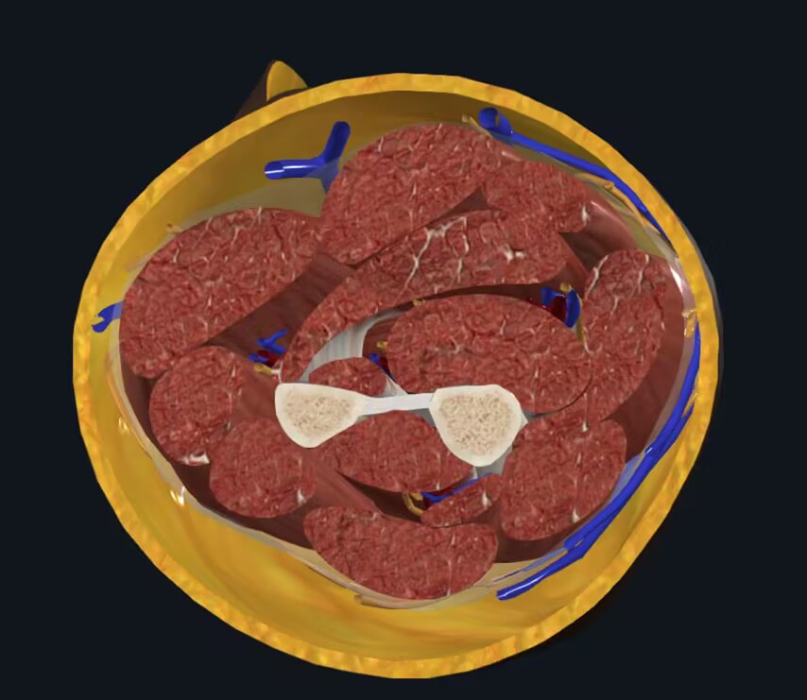
Arm structure
Introduction
Principle
Finished work
Future plan
skin
·Water molecules are polar molecules, which will change direction repeatedly under the influence of microwaves, absorb energy and release energy continuously.
·The phase shift and attenuation of microwave signals triggered by different water contents of the measured object are different.
muscle
bone
Blood vessel
Visualized by Complete Anatomy from Elsevier

Slide 8
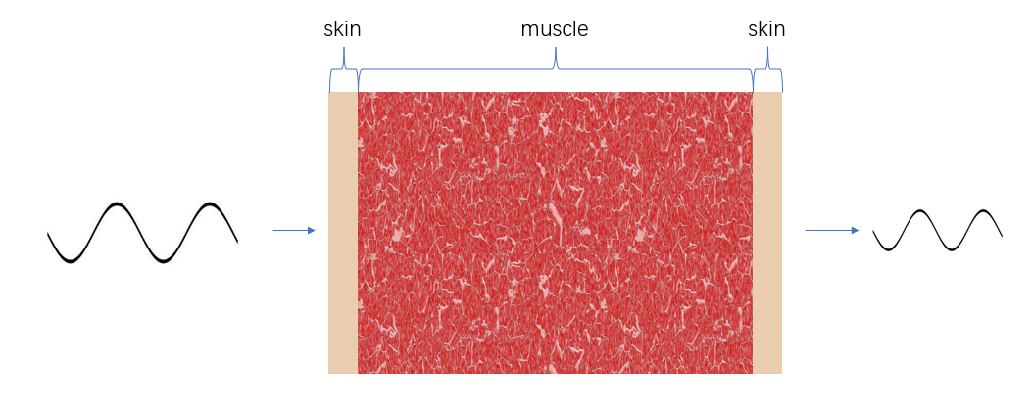
Introduction
Principle
Finished work
Future plan
When the length of the signal source is sufficiently small, it can be treated as a point source. Therefore, when the signal reaches the arm, it can be considered as a plane wave. Hence, the most basic model can be designed as follows.

Slide 9
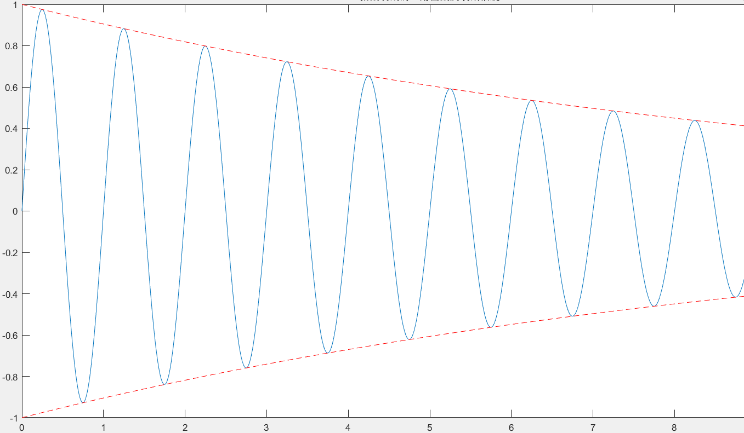
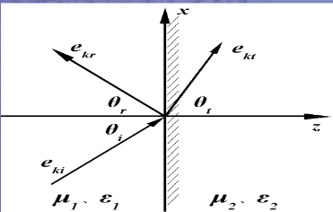





Introduction
Principle
Finished work
Future plan
Theoretical analysis
∇²E - με $\frac{\text{∂}\text{²}\text{E}}{\text{∂}\text{t}\text{²}}$= 0
Attenuation
P(d) = P(d₀) ${\text{e}}^{\text{−}αd}$
Hydration
Permittivity of the body
Prediction of the output signal
Electromagnetic
Transmission
$n$ = $\sqrt{\frac{\text{μ}}{\text{ε}}}$
Reflection
Transmission
$γ$ = $\frac{\text{n}\text{₁ − }\text{n}\text{₂}}{\text{n}\text{₁ + }\text{n}\text{₂}}$
$τ$= $\frac{\text{2}\text{∗}\text{n}\text{₂}}{\text{n}\text{₁ + }\text{n}\text{₂}}$

Slide 10

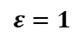
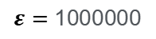
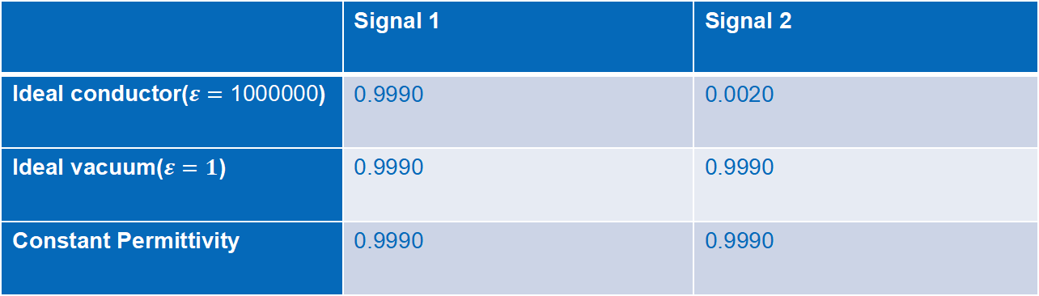
Introduction
Principle
Finished work
Future plan
Validation of the model
 | Signal 1 | Signal 2
Ideal conductor($ε=\text{1000000}$) | 0.9990 | 0.0020
Ideal vacuum($ε=1$) | 0.9990 | 0.9990
Constant Permittivity | 0.9990 | 0.9990
$$ε=1$$
$$ε=1$$
$$ε=1$$
$$ε=\text{1000000}$$
$$ε=1$$

Slide 11
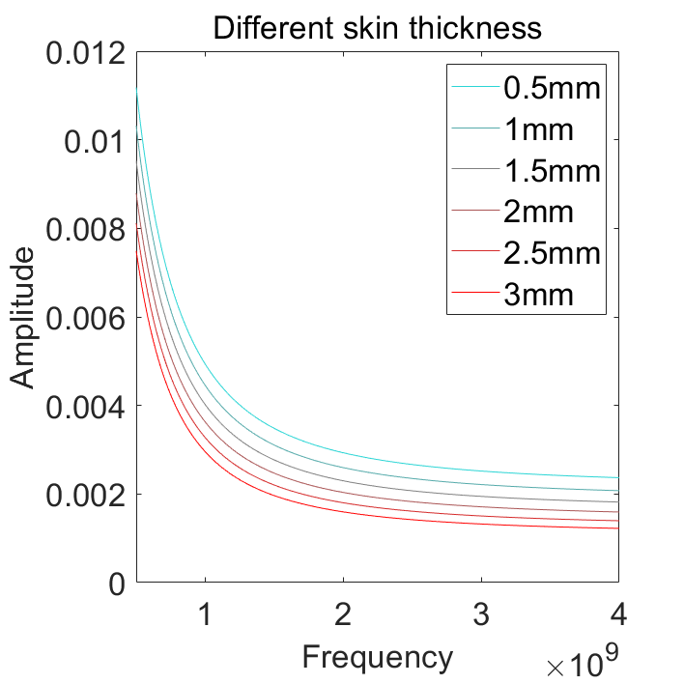
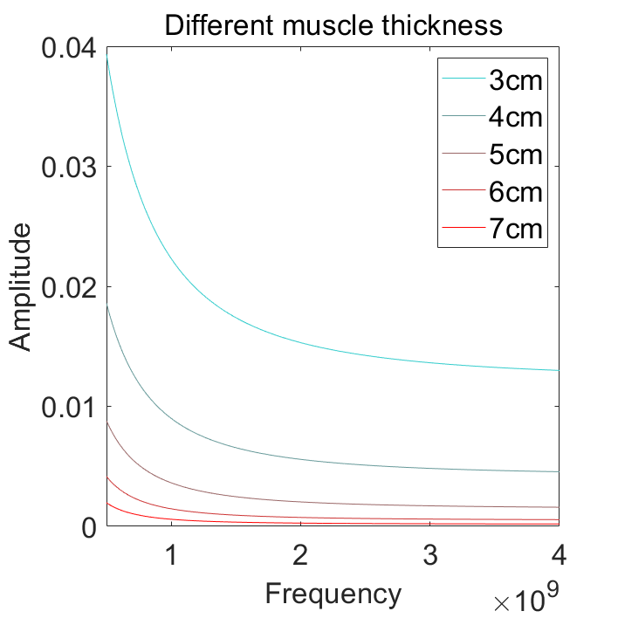
Introduction
Principle
Finished work
Future plan

Slide 12
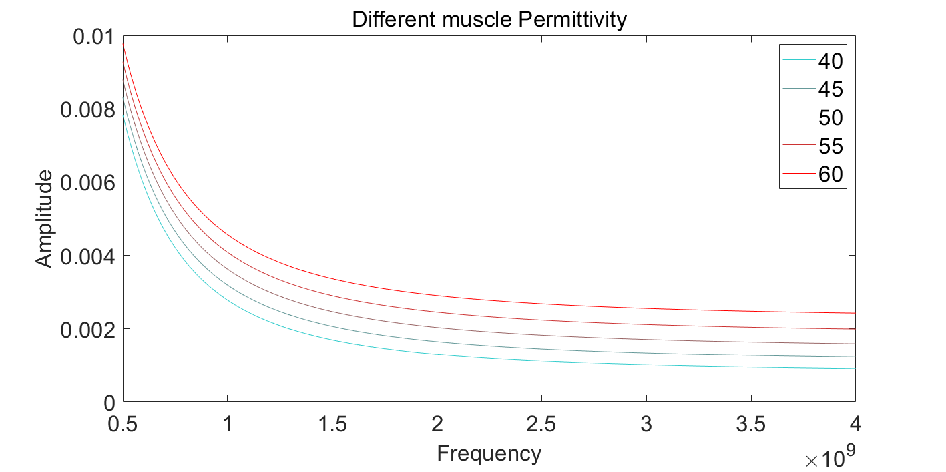
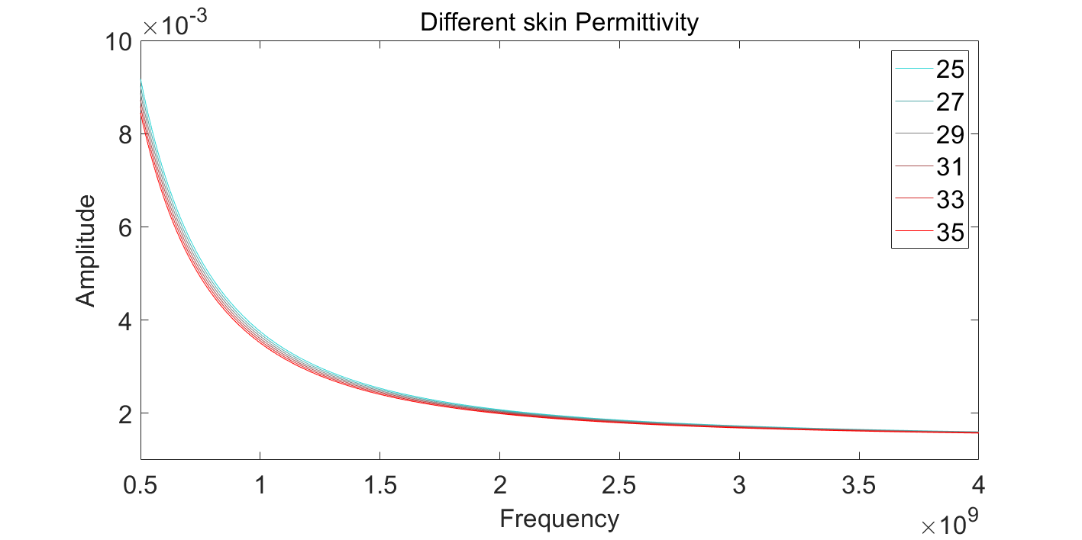
Introduction
Principle
Finished work
Future plan

Slide 13
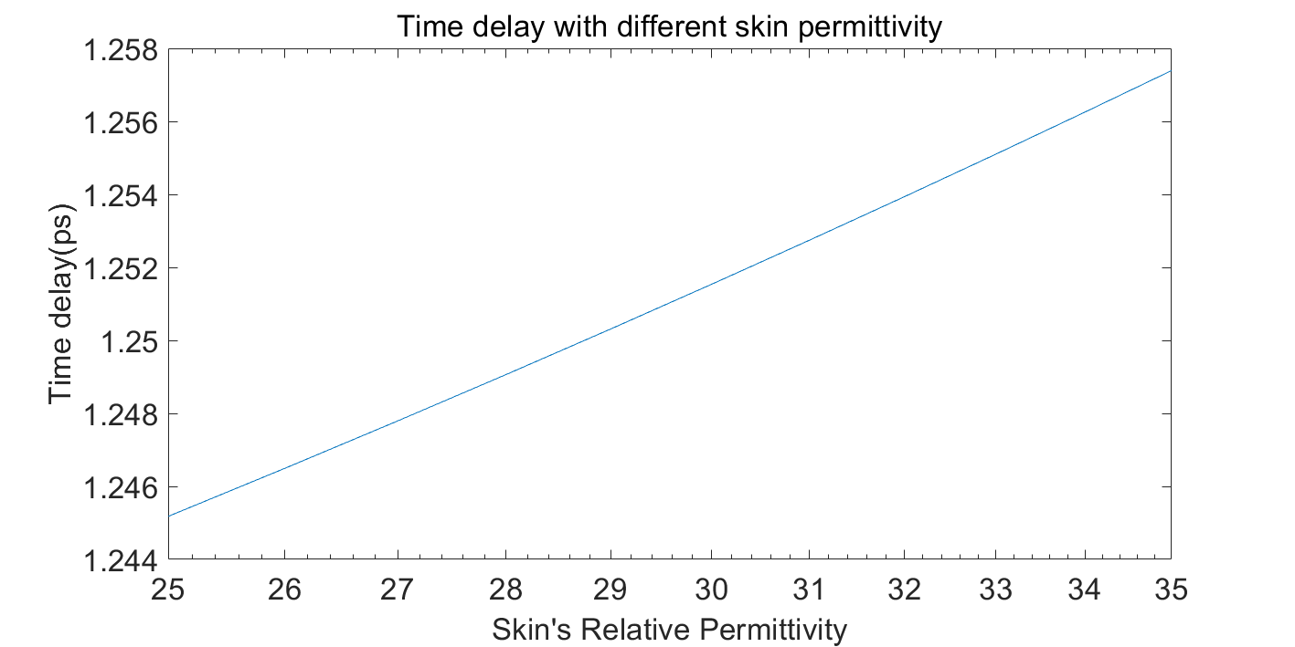
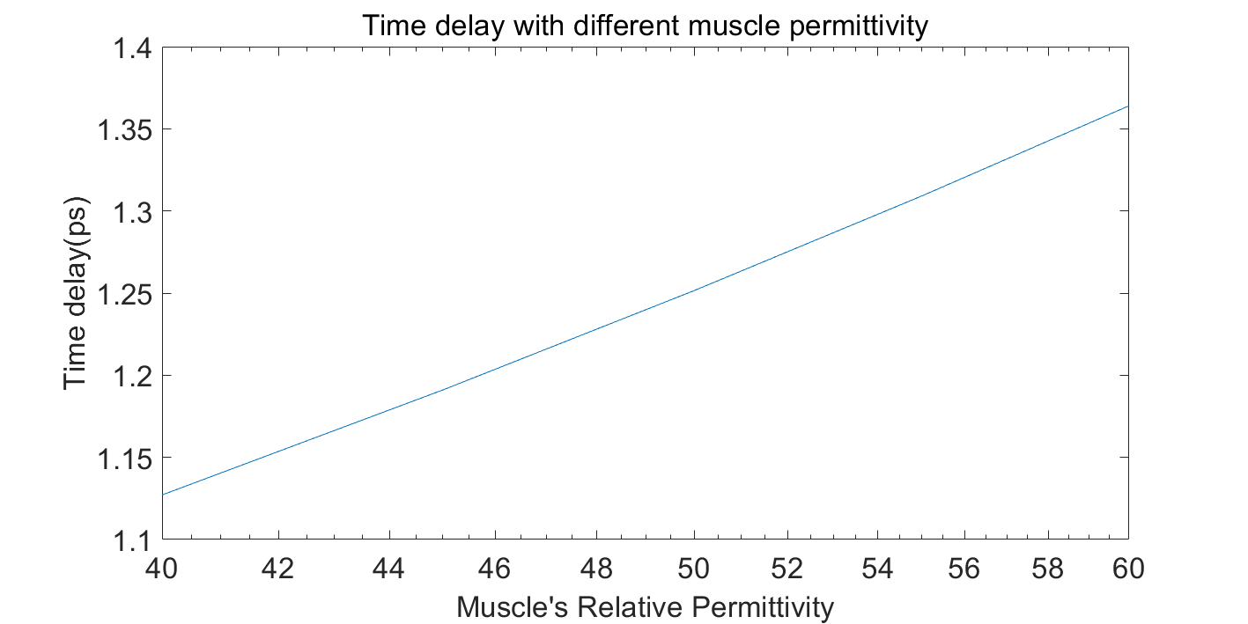
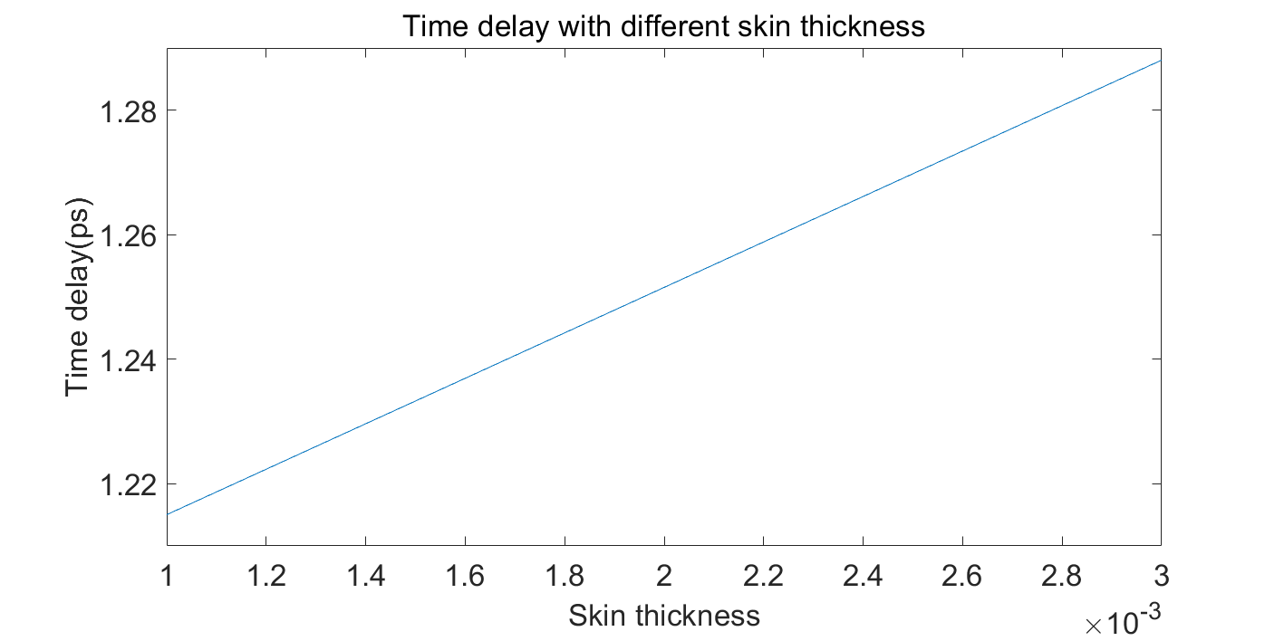
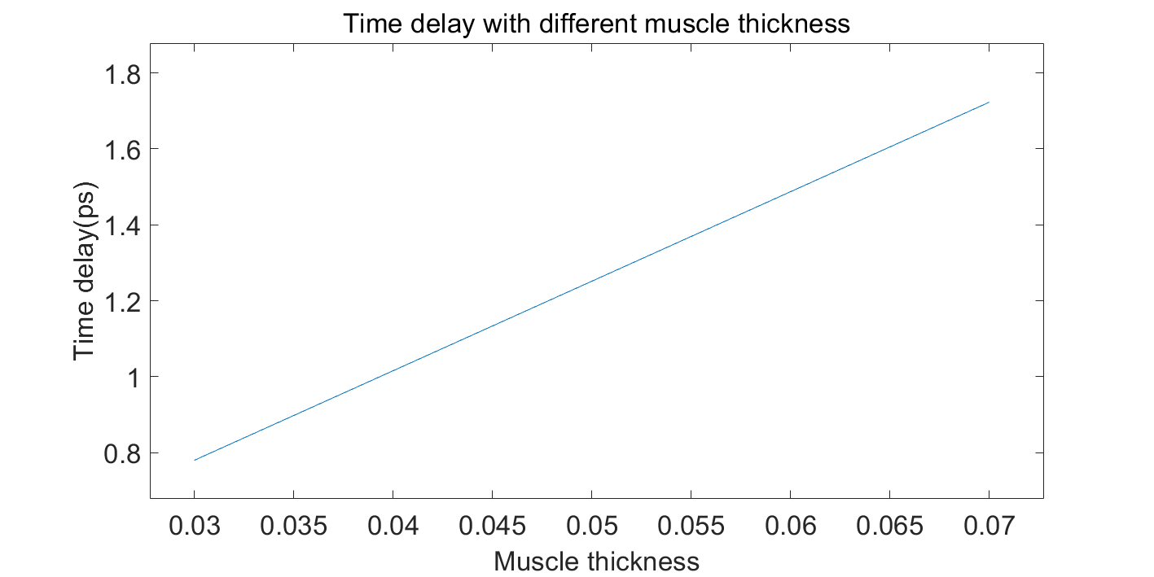
Introduction
Principle
Finished work
Future plan

Slide 14
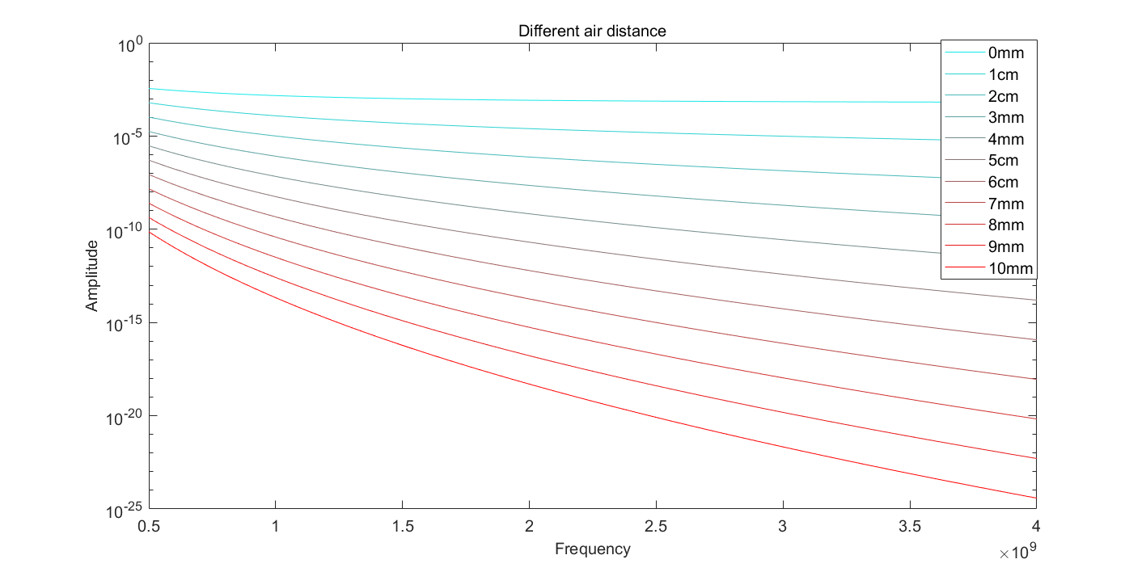
Introduction
Principle
Finished work
Future plan

Slide 15
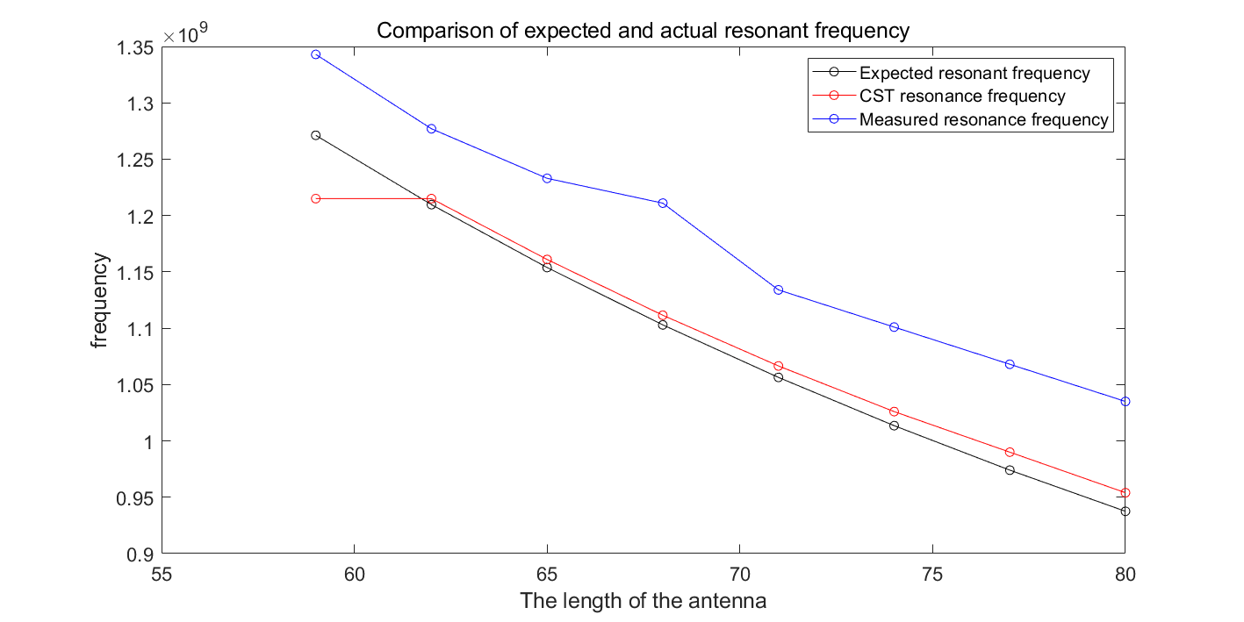
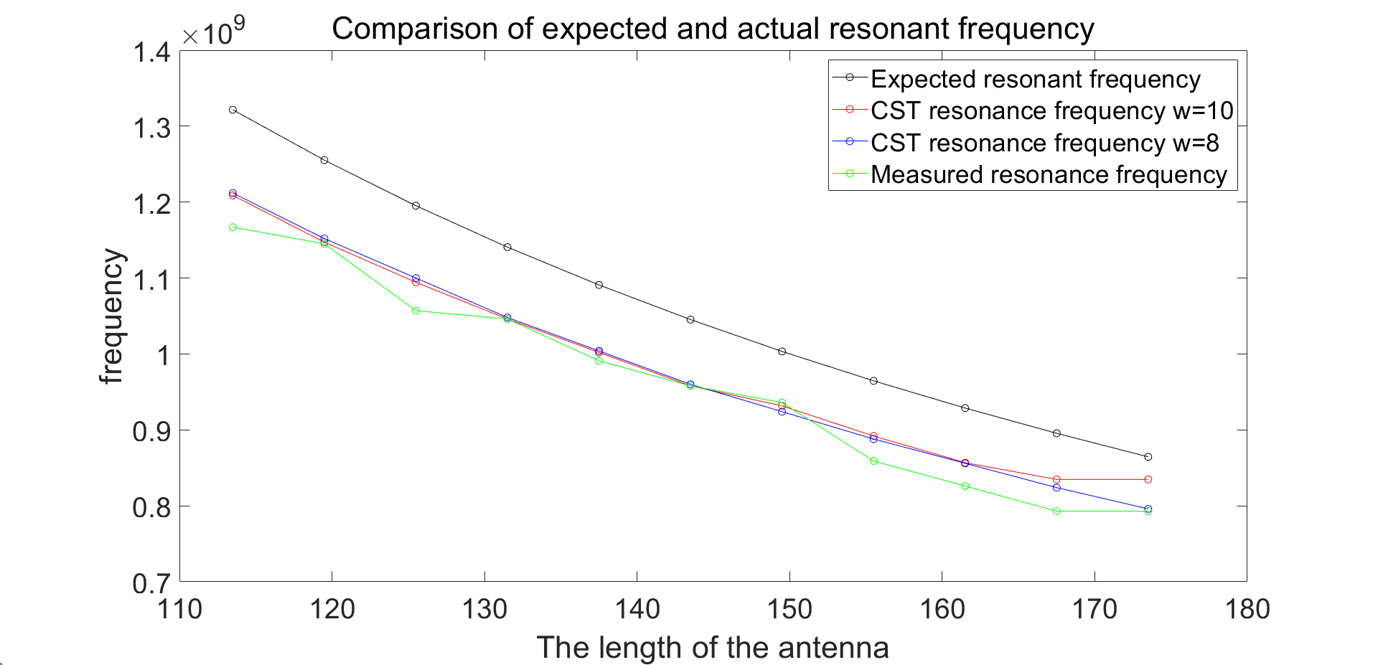
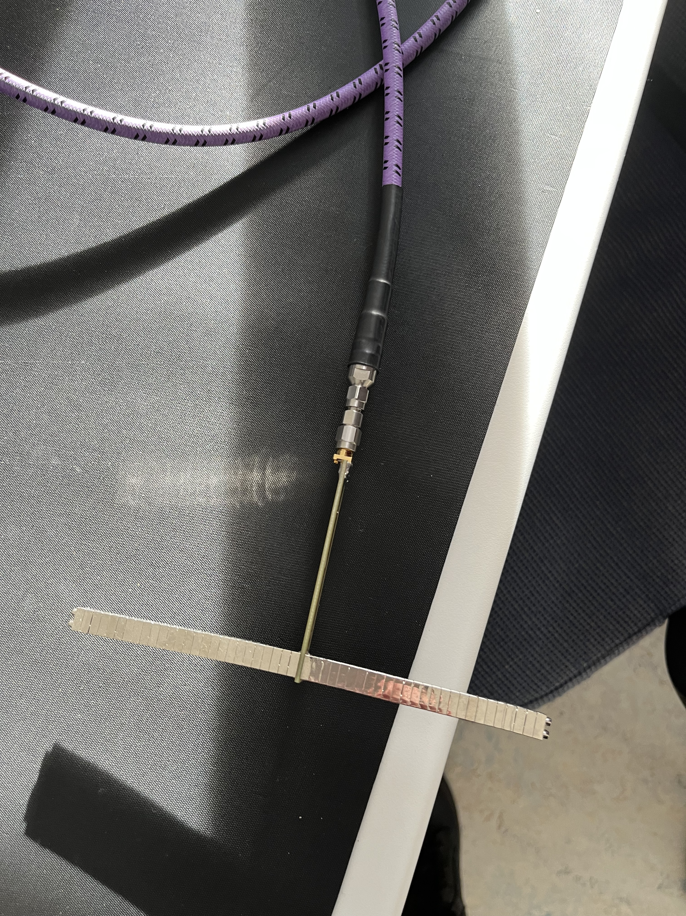
Introduction
Principle
Finished work
Future plan
Monopole
Dipole

Slide 16
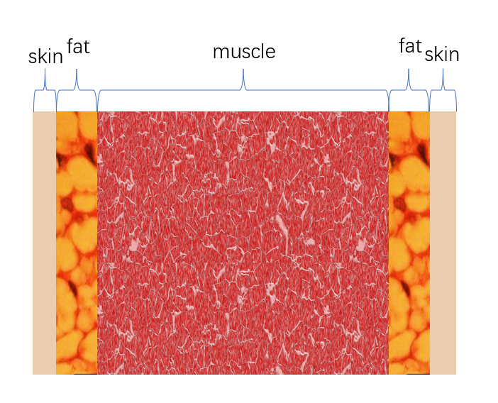
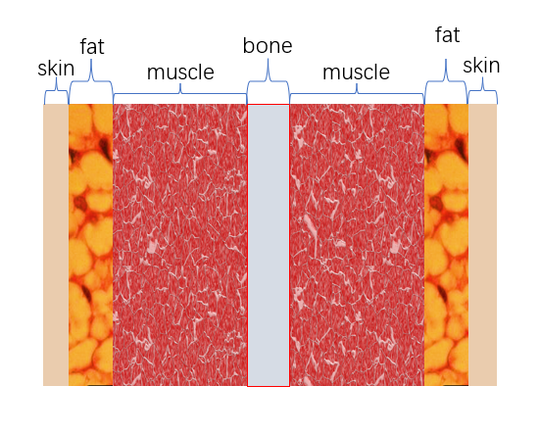
Introduction
Principle
Finished work
Future plan
More complex models explore the effects of different layers.

Slide 17
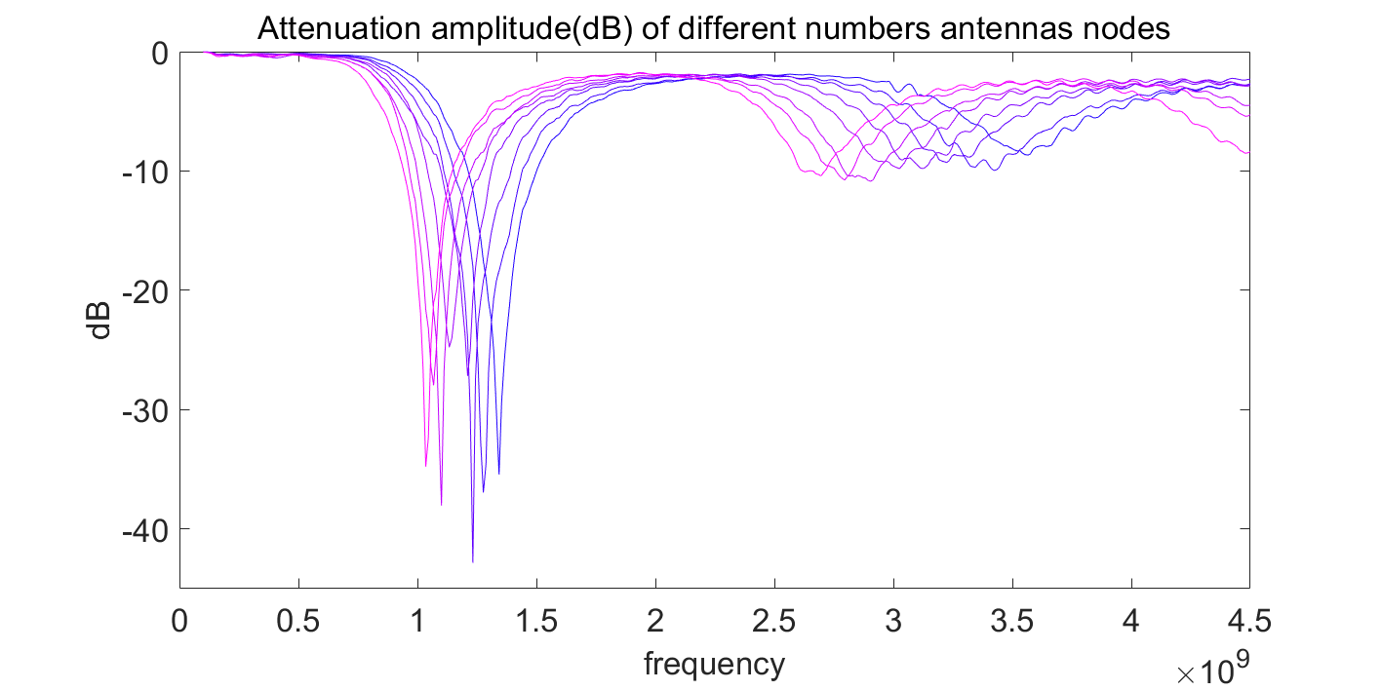
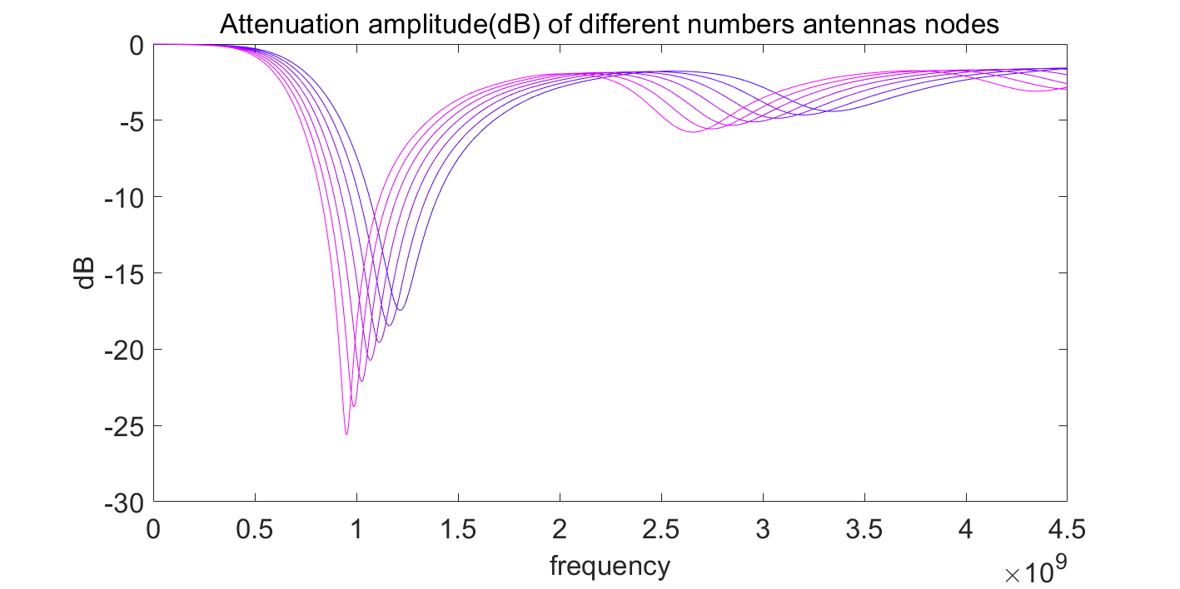
Introduction
Principle
Finished work
Future plan
Actual measurement
· Experimental results
· Simulation results

Slide 18
References
[1]CARTER R, I., CHEUVRONT, S., WILLIAMS, J., KOLKA, M., STEPHENSON, L., SAWKA, M., AND AMOROSO, P. Epidemiology of hospitalizations and deaths from heat illness in soldiers. Medicine Science in Sports Exercise 37, 8 (2005), 1338 – 1344.
[2] SAWKA, M. N., CHEUVRONT, S. N., AND KENEFICK, R. W. Hypohydration and human performance: Impact of environment and physiological mechanisms. SPORTS MEDICINE 45 (2015), S51 – S60.
[3] HARRIS, P. R., KEEN, D. A., CONSTANTOPOULOS, E., WENINGER, S. N., HINES, E., KOPPINGER, M. P., KHALPEY, Z. I., AND KONHILAS, J. P. Fluid type influences acute hydration and muscle performance recovery in human subjects. Journal of the International Society of Sports Nutrition 16, 1 (2019), 1 – 12
[4] ARCÍA-TRABANINO, R., JARQUÍN, E., WESSELING, C., JOHNSON, R. J., GONZÁLEZQUIROZ, M., WEISS, I., GLASER, J., JOSÉ VINDELL, J., STOCKFELT, L., RONCAL, C., HARRA, T., AND BARREGARD, L. Heat stress, dehydration, and kidney function in sugarcane cutters in el salvador – a cross-shift study of workers at risk of mesoamerican nephropathy. Environmental Research 142 (2015), 746 – 755.
[5] JOSEPH C., W., AND WILLIAM B., F. Hydration status and cardiovascular function. Nutrients 11, 8 (2019), 1866.
[6] ARMSTRONG, L. E. Challenges of linking chronic dehydration and fluid consumption to health outcomes. Nutrition reviews 70, suppl_2 (2012), S121–S127.
[7] JOSEPH C., W., AND WILLIAM B., F. Hydration status and cardiovascular function. Nutrients 11, 8 (2019), 1866.
[8] NATALIE A., M., MARK, G., DAVID T., F., LAURIE T., B., AND CARIEN M. VAN, R. Effects of hydration status on cognitive performance and mood. Cambridge, Eng: Cambridge University Press, 2014., 2014.
[9] GANIO, M. S., ARMSTRONG, L. E., CASA, D. J., MCDERMOTT, B. P., LEE, E. C., YAMAMOTO, L. M., MARZANO, S., LOPEZ, R. M., JIMENEZ, L., LE BELLEGO, L., ET AL. Mild dehydration impairs cognitive performance and mood of men. British Journal of Nutrition 106, 10 (2011), 1535–1543.
[10] SUHR, J. A., HALL, J., PATTERSON, S. M., AND NIINISTÖ, R. T. The relation of hydration status to cognitive performance in healthy older adults. International journal of psychophysiology 53, 2 (2004), 121–125.
[11] EL-SHARKAWY, A. M., WATSON, P., NEAL, K. R., LJUNGQVIST, O., MAUGHAN, R. J., SAHOTA, O., AND LOBO, D. N. Hydration and outcome in older patients admitted to hospital (the hoop prospective cohort study). Age and ageing 44, 6 (2015), 943–94
[12] PENG, L., SONG, H., XIAO, X., LIU, G., LU, M., LIU, Y., WEI, B., AND KIKKAWA, T. A fused learning and enhancing method for accurate and noninvasive hydration status monitoring with uwb microwave based on phantom. IEEE Transactions on Microwave Theory and Techniques (2023).

Slide 19
THANK YOU

